Slide 1
Ci3T Implementers Symposium
Elise Sarasin, M.S.E
Stacie Williams, B.S.
Kathleen Lynne Lane, Ph.D., BCBA-D, CF-L2
Mark Buckman, Ph.D.

Slide 3
Agenda
Welcome
Module Exploration
Planning for your 2024-2025 Ci3T Journey
Ci3T Leadership Team Work Time
Break (45 mins)
Setting Up for the Year Ahead
Ci3T Leadership Team Work Time
Wrapping Up and Moving Forward

Slide 4
Welcome
Please pull up your Ci3T Implementation Manual

Slide 5
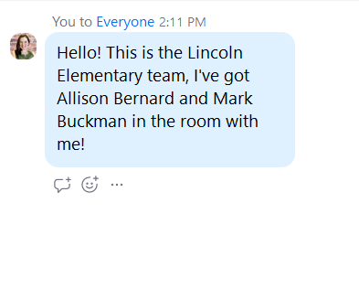
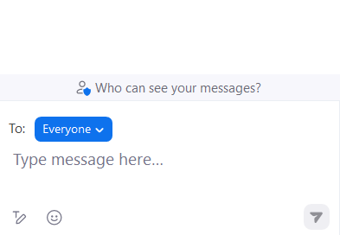
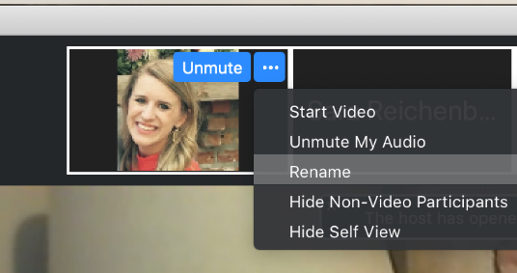
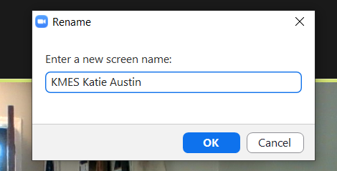
Zoom Logistics
If there are multiple people in the room with you, please list your names in the chat!
To help us put you in breakout rooms with your colleagues today we are renaming you with your school initials and first and last name
If you are facilitating a Ci3T Leadership Team Symposium session at a satellite location, please email us a list of the names, email addresses, and schools of those attending.

Slide 6
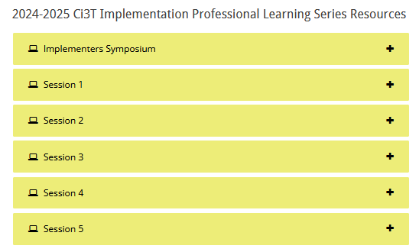
Accessing Professional Learning Materials
You can download the PowerPoint and materials for today’s session in the accordion!

Slide 7
Goals for this Implementation Year
Establish effective Ci3T leadership structures
Gain a deeper understanding of Ci3T models of prevention
Implement your school’s plan with high fidelity
Collect and use social validity and treatment integrity data to monitor Ci3T plan implementation
Collect student academic and behavioral outcome data to inform Ci3T implementation efforts
Share data with all stakeholders regularly (e.g., monthly, quarterly)
Identify areas of additional professional learning for faculty and staff and support faculty and staff access to professional learning
Address any barriers to implementing your Ci3T model

Slide 8
Module Exploration

Slide 9
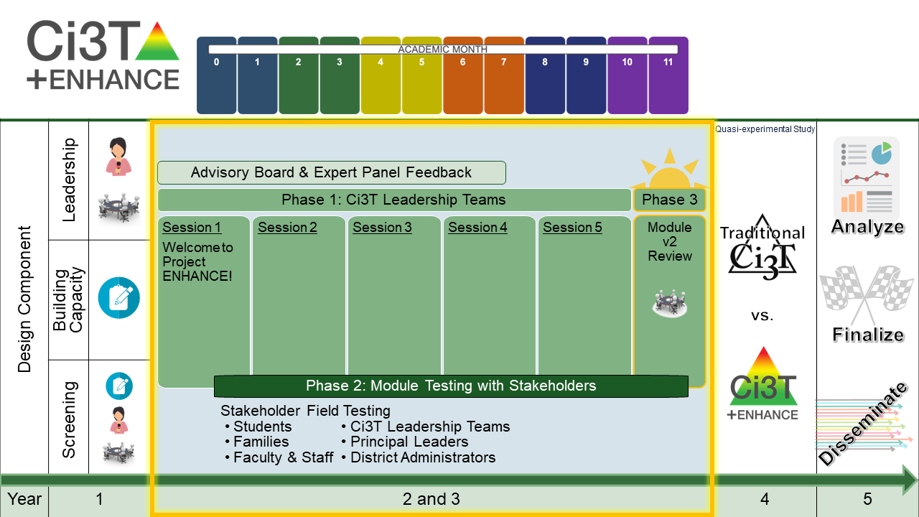
Module Development Process
Notes:
High-level overview of module development process. Highlight:
Year 1 – we listened and learned (survey, interviews, focus groups). Used this to guide the module topics and features. Initially thought we would build 8 modules.
Year 2 & 3 – iterative process. Build module, bring to teams for feedback, integrate feedback. Example – initially gave option interactive resource OR eBook. People wanted both. Feedback people liked and wanted more of the bite-sized pieces (e.g., infographics, videos)
Year 4 & 5 – Continued building and refining modules based on what we had learned and got to use those with schools as part of RCT. Currently have 36.

Slide 11
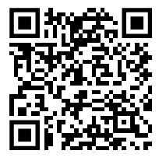
One-Time Module Sign Up
If you have not yet had the opportunity to register, please do so now!
Notes:
Put link in chat: https://kusurvey.ca1.qualtrics.com/jfe/form/SV_5BIl8WmV9EJOSyi

Slide 12
Brief Website Tour
Modules tab
Implementation Manual Crosswalk
Module Support Organizer
Notes:
It can take ~5 minutes for new registrations to process, in the meantime I will walk you through a brief tour of the website and some helpful resources that can guide your module exploration and use.

Slide 13
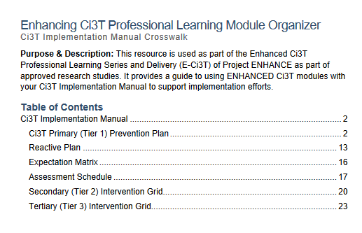
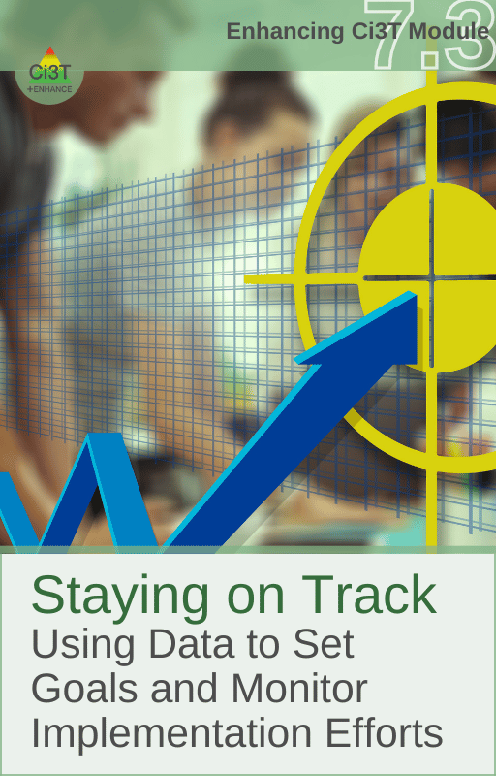
Notes:
15-min timer
We’ve built in the next 15 minutes for free time to explore the modules that are of most interest or relevant to you! You might consider using the Ci3T Implementation Manual Crosswalk to prioritize modules to explore or we’ve included the covers of some modules that might be a good place to start!
We’ll be popping into rooms to provide support if needed! If you get stuck or need help, just come back to the main room and we’re happy to help problem solve.

Slide 14
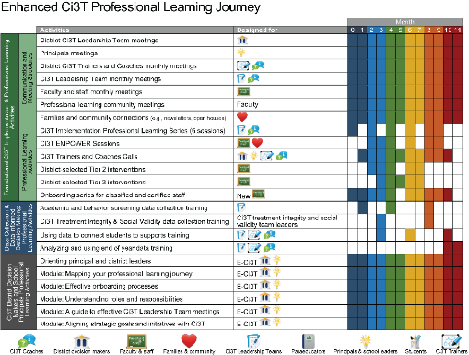
Planning for your 2024-2025 Ci3T Journey
Ci3T Leadership Team Meetings
Faculty & Staff Meetings
Data Collection
Professional Learning

Slide 15
Planning for your 2024-2025 Ci3T Journey
Outcome: prepare your 2024-2025 Ci3T Implementation Calendar

Slide 16
Preparing to Build Your Calendar
You will need:
District Calendar (e.g., parent teacher conferences, breaks)
Assessment schedule
Academic and Behavior Screening Windows
Social Validity & Treatment Integrity Windows
Dates for Professional Learning Opportunities
Ci3T Professional Learning opportunities (e.g., EMPOWER sessions)
District Professional Development Schedule (e.g., faculty meeting 1st Tuesday of the month, weekly PLCs)

Slide 17
Step 1: Schedule Ci3T Leadership Team Meetings & Faculty and Meetings
Ci3T Implementation Sessions
Ci3T Leadership Team Meeting
Faculty & Staff Meeting

Slide 18
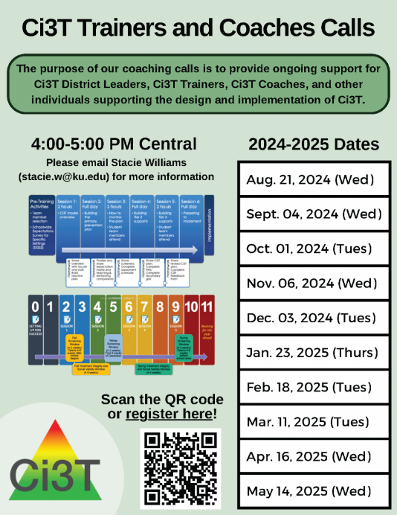
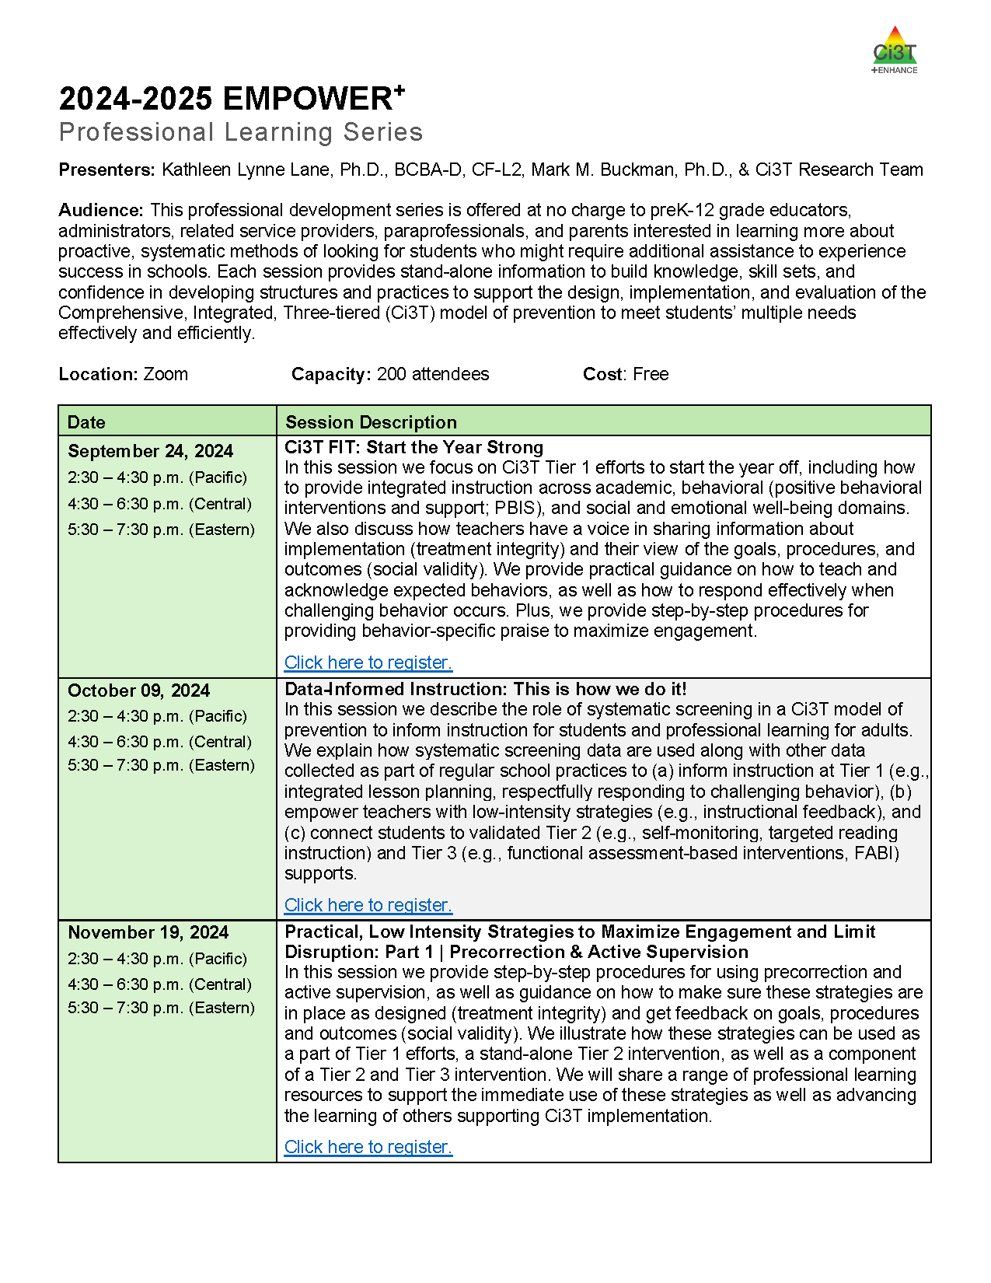
Step 2: Schedule Professional Learning Opportunities
Notes:
This incudes opportunities for your own professional learning as a Ci3T LT member in addition to the professional learning you will offer to faculty and staff.

Slide 19
ENHANCE Ci3T Implementation Professional Learning Series
Ci3T Implementation Professional Learning Series Location: Remote via Zoom Attended by: School Ci3T Leadership Teams Sessions A and B available: Ci3T Leadership Teams can select which they would like to attend.
Session | Date | Times (Session A and B)
 |  | Pacific | Central | Eastern
Summer Session | June. 24, 2024 (Mon) | 07:30 am – 01:30 pm | 09:30 am – 03:30 pm | 10:30 am – 04:30 pm
Session 1 | Sept. 10, 2024 (Tues) | 09:00 am – 11:00 am | 11:00 am – 01:00 pm | 12:00 pm – 02:00 pm
 |  | 02:30 pm – 04:30 pm | 04:30 pm – 06:30 pm | 05:30 pm – 07:30 pm
Session 2 | Nov. 12, 2024 (Tues) | 09:00 am – 11:00 am | 11:00 am – 01:00 pm | 12:00 pm – 02:00 pm
 |  | 02:30 pm – 04:30 pm | 04:30 pm – 06:30 pm | 05:30 pm – 07:30 pm
Session 3 | Jan. 14, 2025 (Tues) | 09:00 am – 11:00 am | 11:00 am – 01:00 pm | 12:00 pm – 02:00 pm
 |  | 02:30 pm – 04:30 pm | 04:30 pm – 06:30 pm | 05:30 pm – 07:30 pm
Session 4 | Mar. 04, 2025 (Tues) | 09:00 am – 11:00 am | 11:00 am – 01:00 pm | 12:00 pm – 02:00 pm
 |  | 02:30 pm – 04:30 pm | 04:30 pm – 06:30 pm | 05:30 pm – 07:30 pm
Session 5 | Apr. 15, 2025 (Tues) | 09:00 am – 11:00 am | 11:00 am – 01:00 pm | 12:00 pm – 02:00 pm
 |  | 02:30 pm – 04:30 pm | 04:30 pm – 06:30 pm | 05:30 pm – 07:30 pm

Slide 20
Project EMPOWER +
Ci3T EMPOWER⁺ Sessions Location: Remote via Zoom Attended by: School Ci3T Leadership Teams, Ci3T District Trainers and Coaches, Faculty and Staff, Families (adults only). Community Members
Session | Date | Times
1. Ci3T FIT: Start the Year Strong | Sep. 24, 2024 (Tues) | 2:30 - 4:30 p.m. (Pacific) 4:30 - 6:30 p.m. (Central) 5:30 - 7:30 p.m. (Eastern)
2. Data-Informed Instruction: This is how we do it! | Oct. 9, 2024 (Wed) | 2:30 - 4:30 p.m. (Pacific) 4:30 - 6:30 p.m. (Central) 5:30 - 7:30 p.m. (Eastern)
3. Practical, Low Intensity Strategies to Maximize Engagement and Limit Disruption: Part 1 | Precorrection & Active Supervision | Nov. 19, 2024 (Tues) | 2:30 - 4:30 p.m. (Pacific) 4:30 - 6:30 p.m. (Central) 5:30 - 7:30 p.m. (Eastern)
4. Practical, Low Intensity Strategies to Maximize Engagement and Limit Disruption: Part 2 | Instructional Choice and Increased Opportunities to Respond | Jan. 22, 2025 (Wed) | 2:30 - 4:30 p.m. (Pacific) 4:30 - 6:30 p.m. (Central) 5:30 - 7:30 p.m. (Eastern)
5. Tier 2: Behavior Contracts | Feb. 11, 2025 (Tues) | 2:30 - 4:30 p.m. (Pacific) 4:30 - 6:30 p.m. (Central) 5:30 - 7:30 p.m. (Eastern)
6. Tier 2: Direct Behavior Ratings (DBR) | Mar. 26, 2025 (Wed) | 2:30 - 4:30 p.m. (Pacific) 4:30 - 6:30 p.m. (Central) 5:30 - 7:30 p.m. (Eastern)
7. Tier 3: Functional Assessment-based Interventions (FABI) | Apr. 29, 2025 (Tues) | 2:30 - 4:30 p.m. (Pacific) 4:30 - 6:30 p.m. (Central) 5:30 - 7:30 p.m. (Eastern)

Slide 21
Ci3T Trainers and Coaches Calls
Ci3T EMPOWER⁺ Sessions Location: Remote via Zoom Attended by: School Ci3T Leadership Teams, Ci3T District Trainers and Coaches, Faculty and Staff, Families (adults only). Community Members
Session | Date | Times (Central
Ci3T Trainers and Coaches Call | Aug. 21, 2024 (Wed) | 4:00 – 5:00 p.m.
Ci3T Trainers and Coaches Call | Sept. 04, 2024 (Wed) | 4:00 – 5:00 p.m.
Ci3T Trainers and Coaches Call | Oct. 01, 2024 (Tues) | 4:00 – 5:00 p.m.
Ci3T Trainers and Coaches Call | Nov. 06, 2024 (Wed) | 4:00 – 5:00 p.m.
Ci3T Trainers and Coaches Call | Dec. 03, 2024 (Tues) | 4:00 – 5:00 p.m.
Ci3T Trainers and Coaches Call | Jan. 23, 2025 (Thurs) | 4:00 – 5:00 p.m.
Ci3T Trainers and Coaches Call | Feb. 18, 2025 (Tues) | 4:00 – 5:00 p.m.
Ci3T Trainers and Coaches Call | Mar. 11, 2025 (Tues) | 4:00 – 5:00 p.m.
Ci3T Trainers and Coaches Call | Apr. 16, 2025 (Wed) | 4:00 – 5:00 p.m.
Ci3T Trainers and Coaches Call | May 14, 2025 (Wed) | 4:00 – 5:00 p.m.

Slide 22
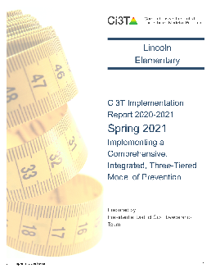
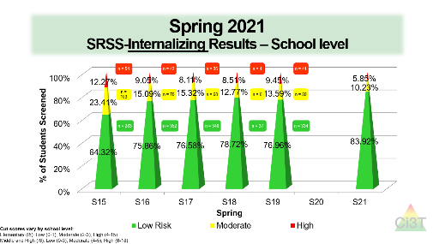
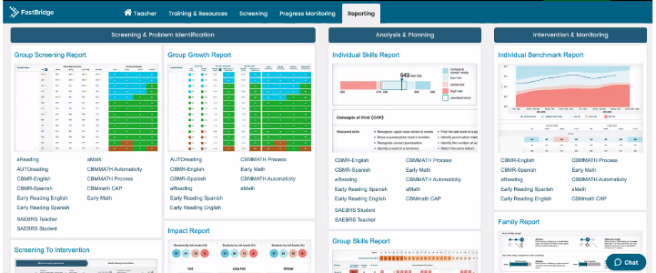
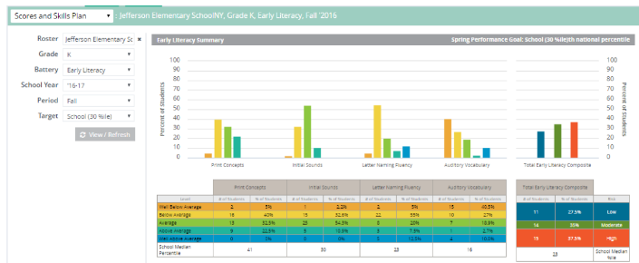
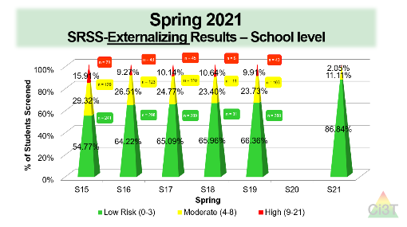
Responding to Spring Data
What professional learning is necessary to respond to screening, treatment integrity, and social validity data?

Slide 23
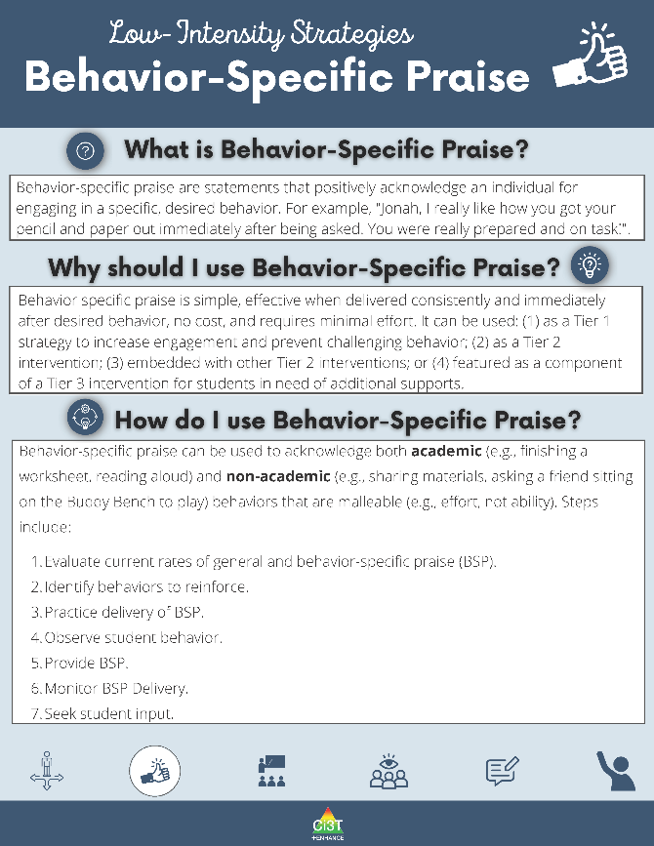
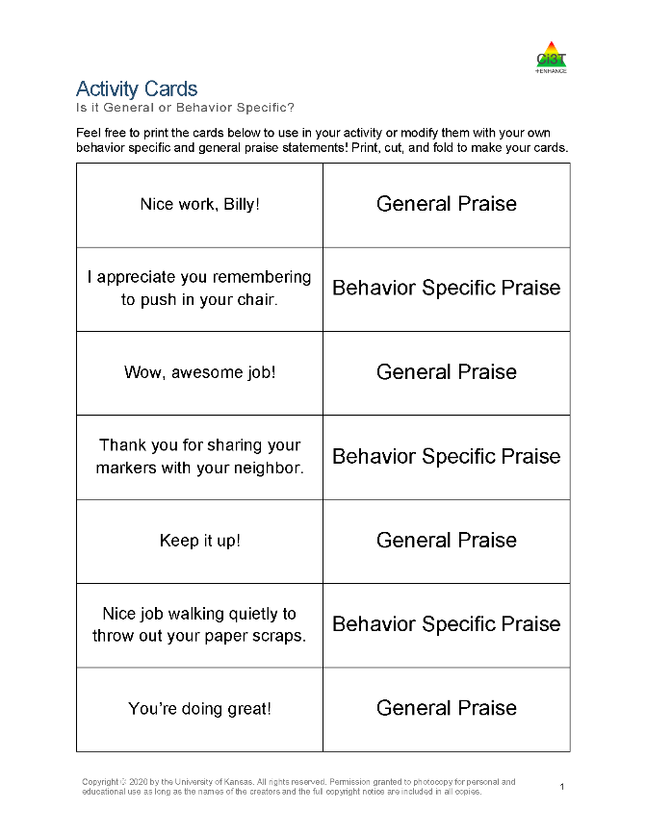
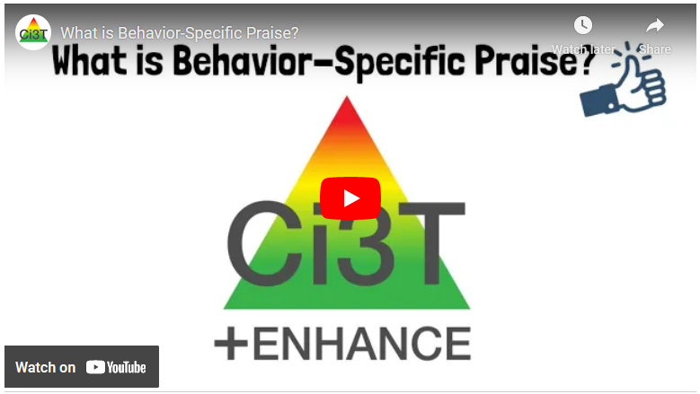
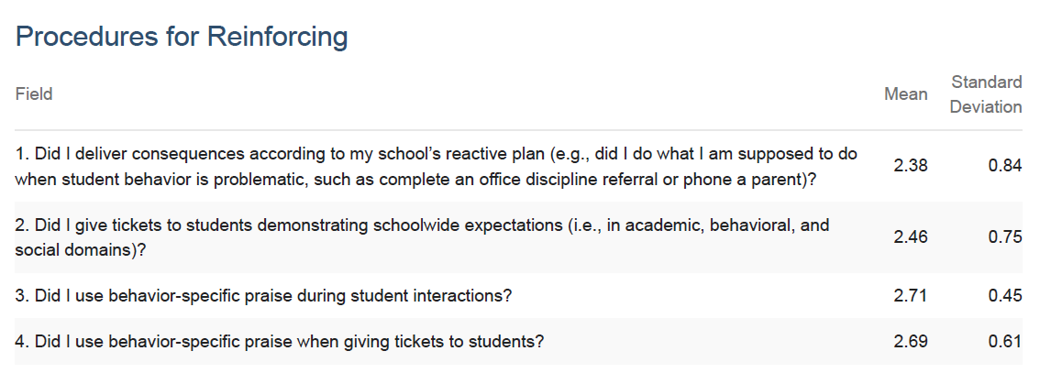
Stand Alone Professional Learning
Notes:
Based on Treatment Integrity data, might decide to set a goal around Behavior Specific Praise. Schedule a stand-alone PD during faculty and staff meeting or teacher workday.
During this time, you could leverage module materials such as: an editable PowerPoint, video, infographics, or this built in general praise versus BSP activity.

Slide 24
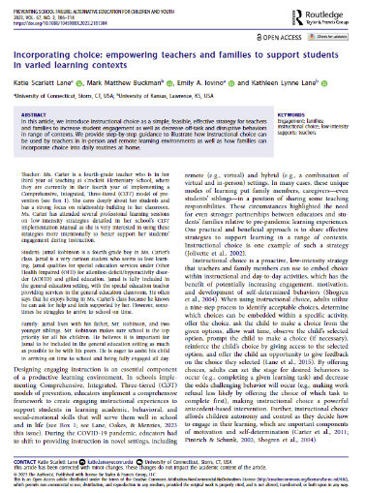
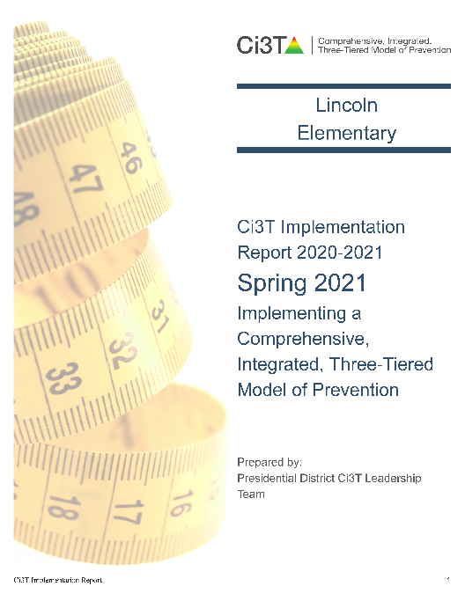
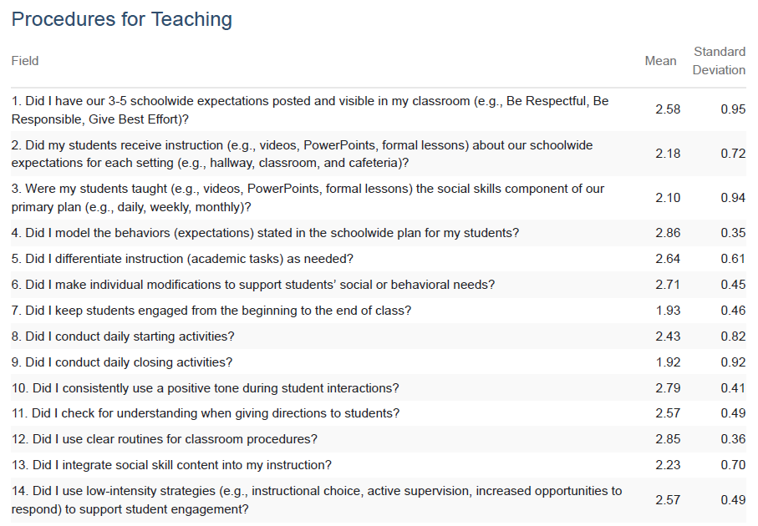
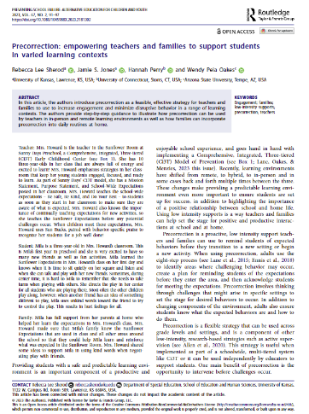
Professional Learning Series – Book Club

Slide 25
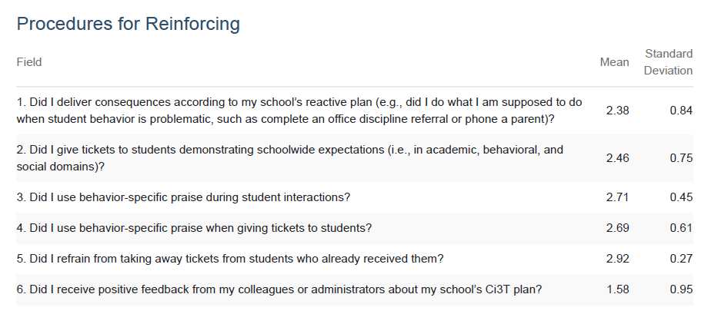
Standing Agenda Item
10 Minute Tip for Success
Highlight & Celebrate Staff
Share Monthly Data
Notes:
Low on getting recognition / looking at data
10 minute tip for success
Highlight teachers/celebrate
Share monthly data

Slide 26
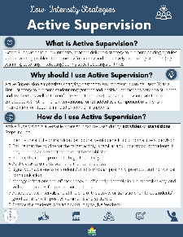
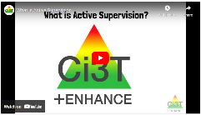
Embed into Existing Communication
Hi Lincoln Elementary!
Happy Monday ☺
Our strategy of the month is active supervision! Check out this video (3 mins) to learn more! This week, in PLCs your team will select a setting (e.g., playground) to
focus your active supervision
efforts. Come with ideas!
Hi Lincoln Elementary!
Happy Monday ☺
This week we will continue
our focus on active
Supervision! If you’d like a
refresher – please check
out this infographic!
Hi Lincoln Elementary!
Happy Monday ☺
As we close out this month, I wanted to
shout out a few teammates who are
crushing their active supervision goals!
Check out these videos for examples of
active supervision in action!
Notes:
You might also consider taking advantage of existing communication structures like a weekly email or staff newsletter. In these communications you can sprinkle in infographics, videos, and highlight examples of the experts in your building.

Slide 27
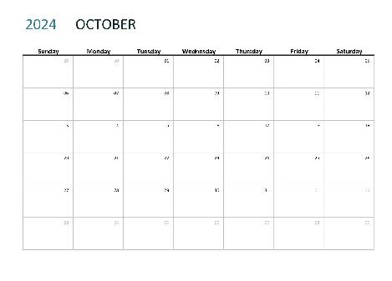
Step 3: Schedule Professional Learning to Support Data Collection and Data-informed Decision Making
First – add academic and behavior screening windows and treatment integrity and social validity windows to your calendar
Then, use this these windows to backwards plan:
Agenda items for Ci3T Leadership Team Meeting
Faculty & Staff Meetings
Additional Professional Learning

Slide 28
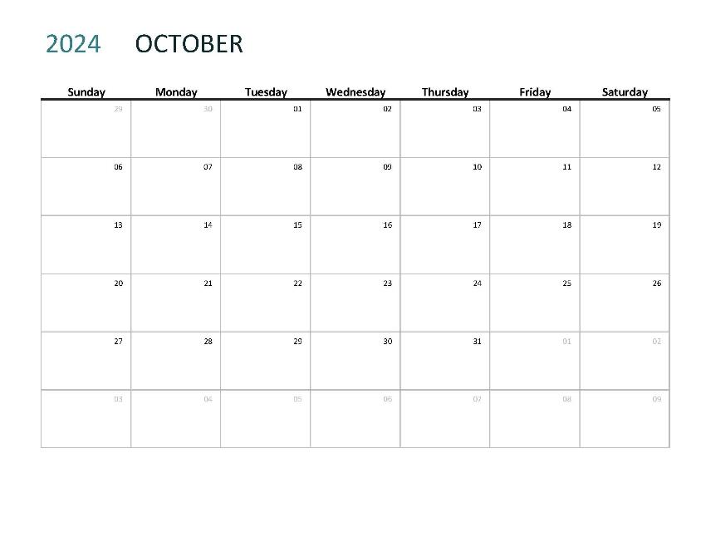
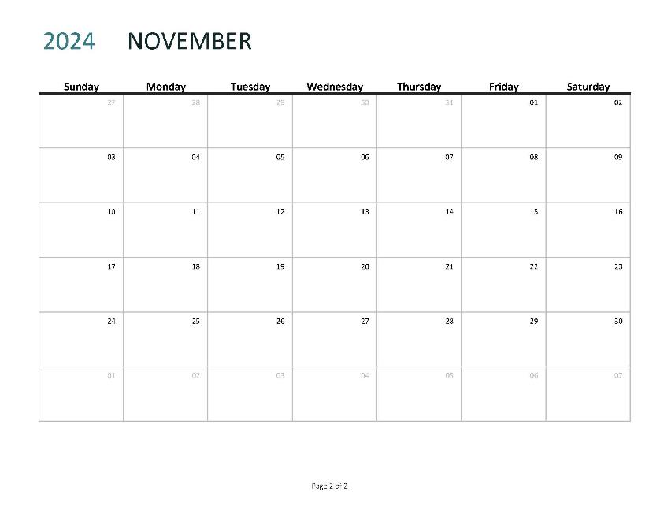
You might allocate this faculty meeting to prepare for parent teacher conferences
Parent Teacher Conferences
Which means time for treatment integrity and social validity might need to happen later in the window
When during this window can we set aside time during a faculty meeting for staff to complete these measures?

Slide 29
Faculty and Staff Complete SV & TI
Parent Teacher Conferences
Consider allocating an existing Ci3T Leadership Team meeting towards TFI completion
We also need to complete the TFI during this window. When will our Ci3T Leadership Team meet to do this?

Slide 30
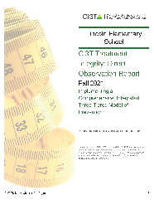
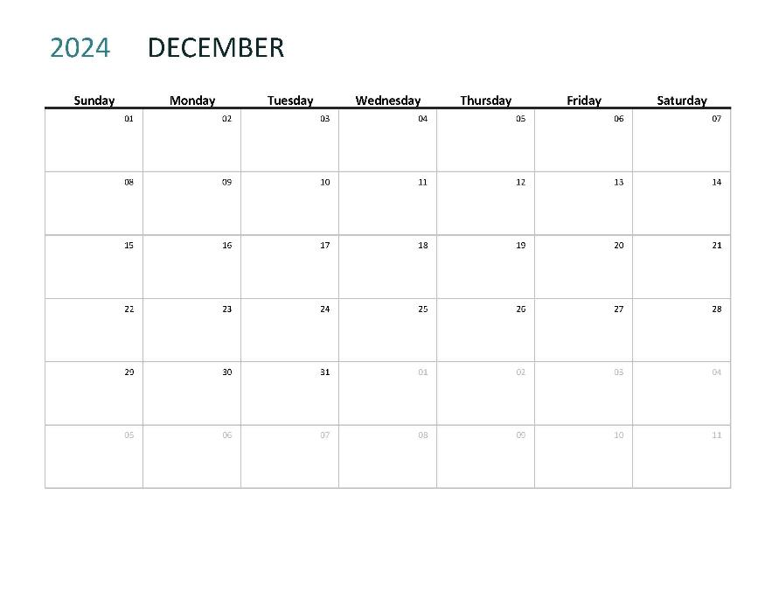
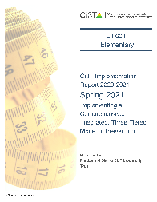
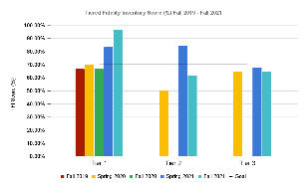
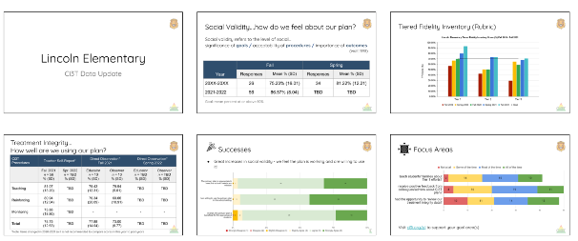
When will our Ci3T Leadership team meet to review these data?
Review TI & SV Reports
Share TI & SV with Staff
When will we share out these data with faculty and staff?

Slide 31
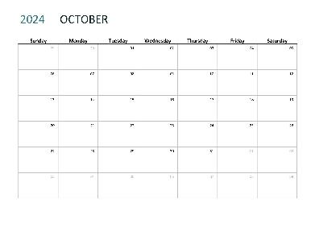
Let’s talk… and make plans!
Prepare your 2024-2025 Ci3T Implementation Calendar
Ci3T Leadership Team monthly meeting dates
Faculty and Staff monthly meeting dates
Professional learning opportunities
EMPOWER Session
Coaches and Trainers calls
School-level trainings (e.g., PLCs, faculty meetings, book clubs)
Professional learning to support data collection and data-informed decision making
Academic and behavior screening (fall, winter, spring)
Treatment integrity & social validity (fall, spring)

Slide 32
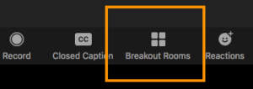
Work Time Logistics
Enjoy this planning block with your team!
We will come back together at:
Handouts and materials
can be downloaded directly
from our website!
10:10 am PST | 12:10 pm CST | 1:10 pm EST
Notes:
Link to materials: https://www.ci3t.org/imp

Slide 33
Wrap Up & Next Steps
Outcome
Prepare your 2024-2025 Ci3T Implementation Calendar
Enjoy your break! See you back at:
11:00 PST 1:00 CST 2:00 EST
Notes:
Stamp – during that block of time you started to map out professional learning journey.
Break

Slide 34
Setting Up for the Year Ahead
Welcoming back the adults in your building
Welcoming back students and families

Slide 35
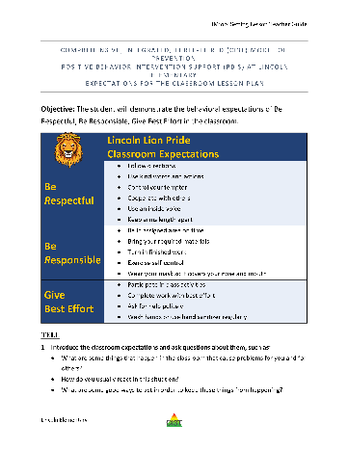
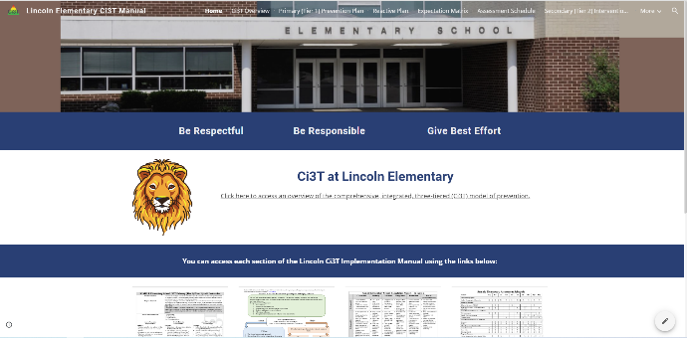
Setting up for the year ahead
Outcome: plan a beginning of year roll out to welcome faculty, staff, families, and students and share key information from your school’s Ci3T Implementation Manual

Slide 36
Ci3T Primary Plan: Faculty and Staff Roles and Responsibilities

Slide 37
Academics
Area II: Academics Responsibilities Faculty and Staff: Teach core programs according to district and state standards with integrity Use teacher-delivered, low-intensity strategies to support students’ active engagement | Area II: Behavior Responsibilities Faculty and Staff: Implement Positive Behavioral Interventions and Supports (PBIS) with integrity. Teach all setting Expectations within the first week of school and reteach Expectations (monthly). Display and model school-wide expectations in classrooms and other key settings. Implement the reactive plan with integrity. | Area II: Social Responsibilities Faculty and Staff: Teach schoolwide social skills/ character education curricula with integrity: Teach daily Second Step ® lessons (link to grade level instructional schedules) Seek ways to engage parents as partners in the school program

Slide 38
Academics
Area II: Academics Responsibilities Faculty and Staff: Teach core programs according to district and state standards with integrity Use teacher-delivered, low-intensity strategies to support students’ active engagement | Area II: Behavior Responsibilities Faculty and Staff: Implement Positive Behavioral Interventions and Supports (PBIS) with integrity. Teach all setting Expectations within the first week of school and reteach Expectations (monthly). Display and model school-wide expectations in classrooms and other key settings. Implement the reactive plan with integrity. | Area II: Social Responsibilities Faculty and Staff: Teach schoolwide social skills/ character education curricula with integrity: Teach daily Second Step ® lessons (link to grade level instructional schedules) Seek ways to engage parents as partners in the school program

Slide 39
Ci3T Primary Plan: Faculty and Staff Roles and Responsibilities

Slide 40
Behavioral
Area II: Academics Responsibilities Faculty and Staff: Teach core programs according to district and state standards with integrity: Use teacher-delivered, low-intensity strategies to support students’ active engagement | Area II: Behavior Responsibilities Faculty and Staff: Implement Positive Behavioral Interventions and Supports (PBIS) with integrity. Teach all setting Expectations within the first week of school and reteach Expectations (monthly). Display and model school-wide expectations in classrooms and other key settings. Implement the reactive plan with integrity. | Area II: Social Responsibilities Faculty and Staff: Teach schoolwide social skills/ character education curricula with integrity: Teach daily Second Step ® lessons (link to grade level instructional schedules) Seek ways to engage parents as partners in the school program

Slide 41
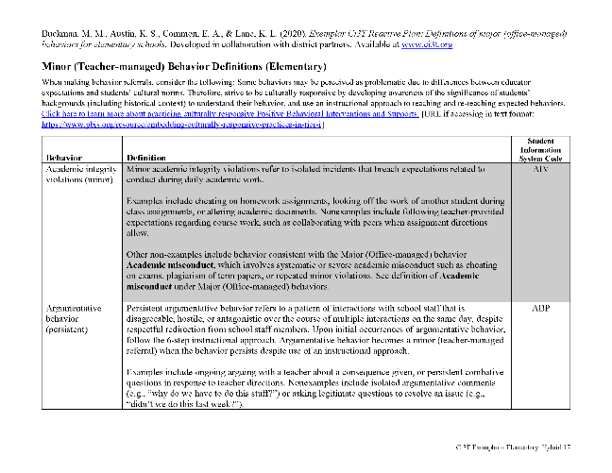
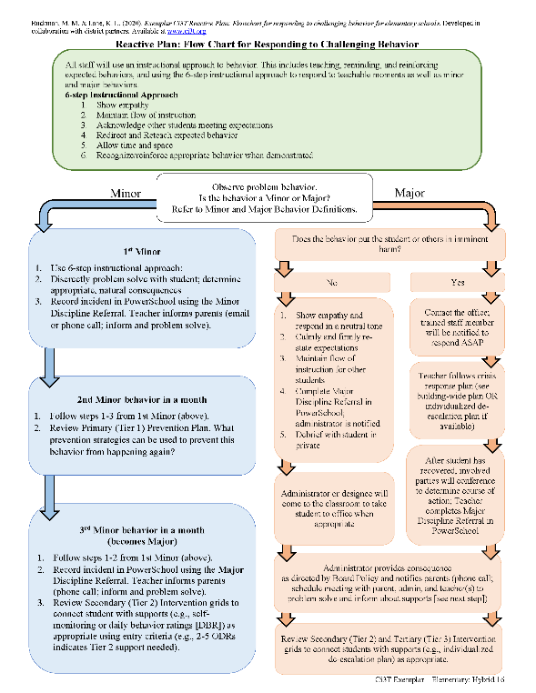
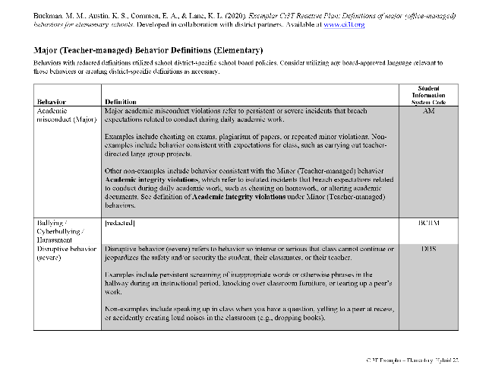
Behavioral
Area II: Academics Responsibilities Faculty and Staff: Teach core programs according to district and state standards with integrity: Use teacher-delivered, low-intensity strategies to support students’ active engagement | Area II: Behavior Responsibilities Faculty and Staff: Implement Positive Behavioral Interventions and Supports (PBIS) with integrity. Teach all setting Expectations within the first week of school and reteach Expectations (monthly). Display and model school-wide expectations in classrooms and other key settings. Implement the reactive plan with integrity. | Area II: Social Responsibilities Faculty and Staff: Teach schoolwide social skills/ character education curricula with integrity: Teach daily Second Step ® lessons (link to grade level instructional schedules) Seek ways to engage parents as partners in the school program

Slide 42
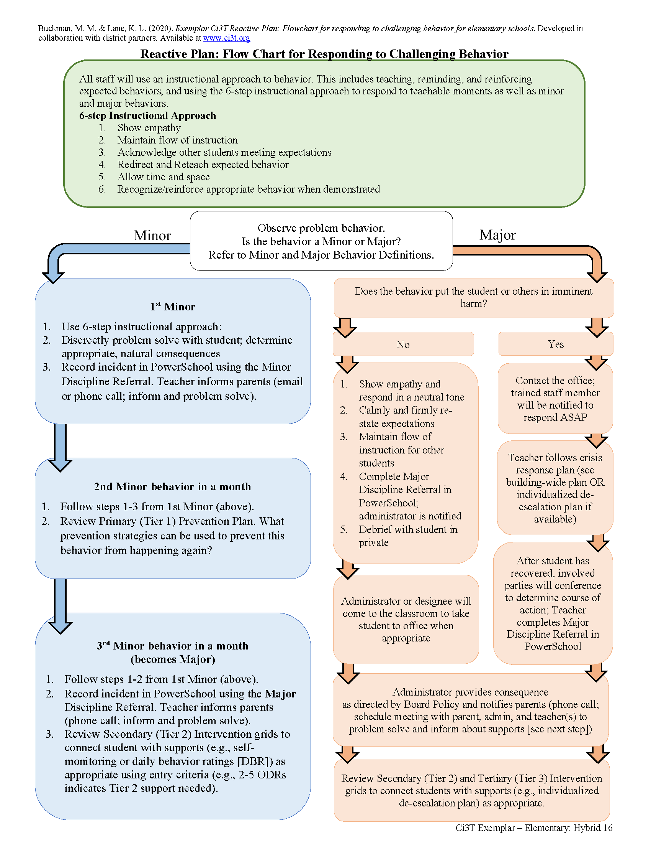

Slide 44
Module Connection!

Slide 45
Ci3T Primary Plan: Faculty and Staff Roles and Responsibilities

Slide 46
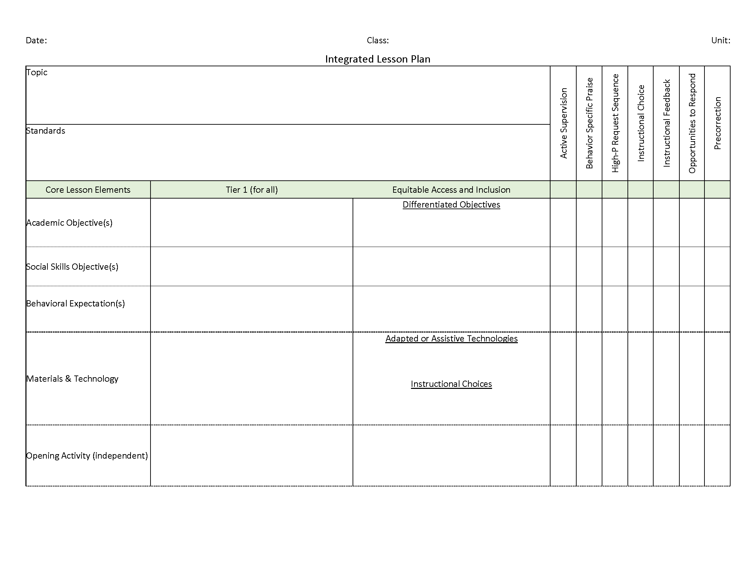
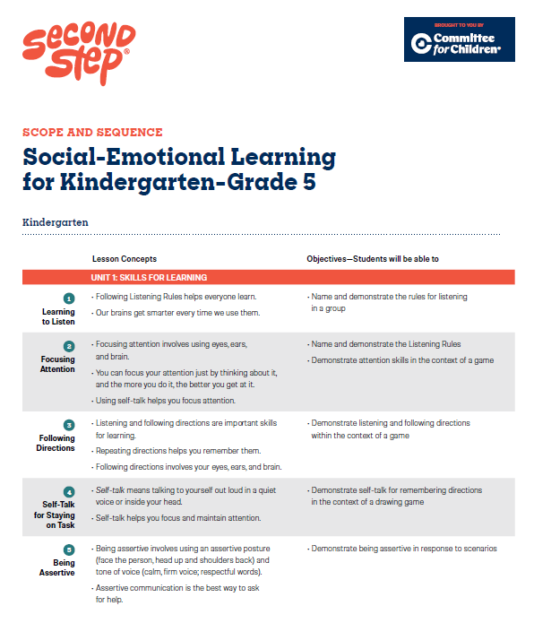
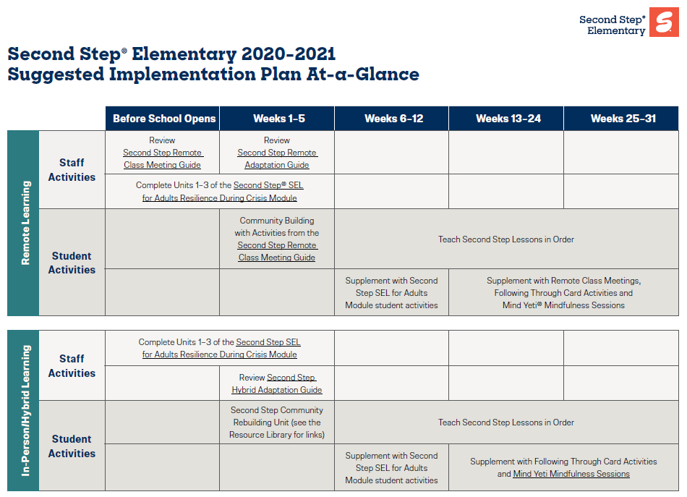
Social-Emotional Well-being
Area II: Academics Responsibilities Faculty and Staff: Teach core programs according to district and state standards with integrity: Use teacher-delivered, low-intensity strategies to support students’ active engagement | Area II: Behavior Responsibilities Faculty and Staff: Implement Positive Behavioral Interventions and Supports (PBIS) with integrity. Teach all setting Expectations within the first week of school and reteach Expectations (monthly). Display and model school-wide expectations in classrooms and other key settings. Implement the reactive plan with integrity. | Area II: Social Responsibilities Faculty and Staff: Teach schoolwide social skills/ character education curricula with integrity: Teach daily Second Step ® lessons (link to grade level instructional schedules) Seek ways to engage parents as partners in the school program

Slide 47
Procedures for Teaching
How will the Ci3T Leadership Team help teach the Ci3T plan to:
Faculty and Staff
Students
Families and Community

Slide 48
Procedures for Teaching – Module Highlights

Slide 49
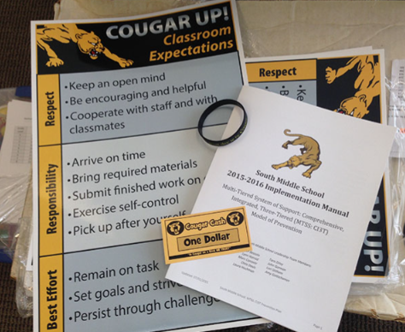
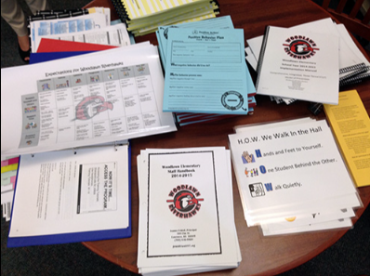
Beginning of year rollout for staff
Locate in your Ci3T Implementation Manual

Slide 50
Beginning of year rollout for staff
Notes:
Brief video overview for new faculty, staff, substitutes, bus drivers
Scavenger hunt of Ci3T manual and / or the Ci3T website – a sample scavenger hunt is available in The Tier 2 Process Module

Slide 51
Beginning of year rollout for staff
New staff PD
Notes:
Onboarding and professional development opportunities for new staff
Calendar of scope and sequence for social skills lessons

Slide 52
Beginning of year rollout for students
Templates (and exemplars!) of this
expectation lesson plan and expectations
PowerPoint are available for you to
customize!
Locate in your Ci3T Implementation Manual

Slide 53
Beginning of year rollout for students
You might consider updating your Ci3T Implementation Calendar to include key dates for beginning of year roll out such as:
Beginning of the year kick off assembly
Behavior expectations lessons (by setting)

Slide 54
Beginning of year rollout for families
Locate in your Ci3T Implementation Manual
Notes:
Consider opportunities to share about Ci3T with families such as back to school night or open house, brochures, and updating your school website. You might also consider sharing infographics featured in this module!

Slide 55
Procedures for Reinforcing
How will the Ci3T Leadership Team reinforce behavior related to implementing the plan for:
Faculty and Staff
Students
Families and Community

Slide 56
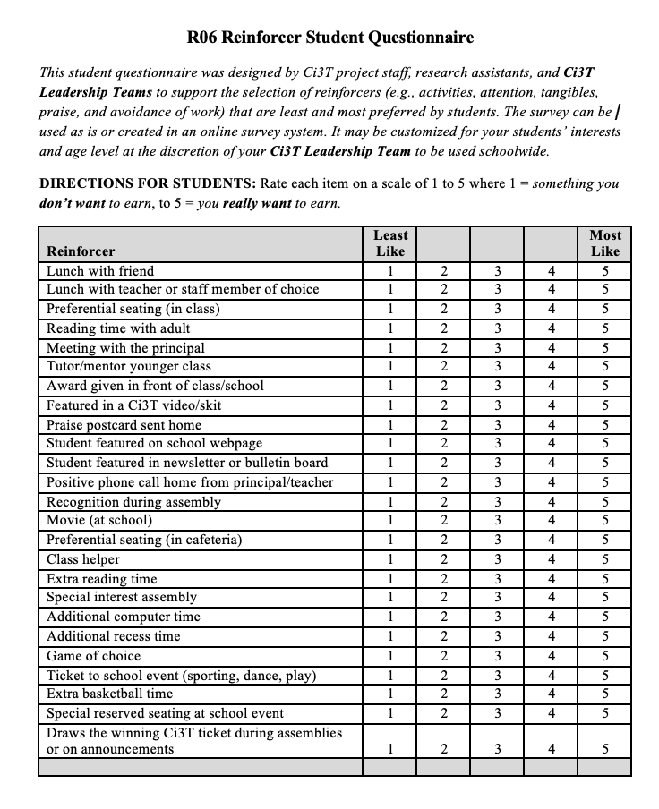
Students
Locate in your Ci3T Implementation Manual

Slide 57
Add to your Ci3T Implementation Calendar
You might consider updating your Ci3T Implementation Calendar to include key dates for reinforcement such as:
School store
Assemblies
Trips / events

Slide 58
Staff
Locate in your Ci3T Implementation Manual
(1) day of recess coverage

Slide 59
Let’s talk… and make plans!
Prepare beginning of year roll out of your Ci3T plan
What professional learning is needed to onboard new staff?
What beginning of year professional learning is needed for all staff (e.g., understanding tickets and reinforcement, integrated lesson planning).
How and when will expectations lessons be taught to students?
How and when will you share your Ci3T plan with families and the community?
What procedures for reinforcement are in place for students?
How will you reinforce staff for implementing your school’s Ci3T plan?

Slide 60
Wrapping Up and Moving Forward

Slide 61
Wrap Up
Today we spent time:
Module Exploration
Planning for your 2024-2025 Ci3T Journey
Academic and Behavior Screening
Treatment Integrity and Social Validity
Ci3T Leadership Team Meeting
Faculty & Staff Meetings
Professional Learning
Setting up for the year ahead
Beginning of year roll out for staff, students, and families

Slide 62
Next Steps
Finalize your 2024-2025 Ci3T Implementation Manual
Ensure all Ci3T implementation materials (e.g., tickets, expectation posters) are prepared for the first day of school
Implement your plan to teach the Ci3T plan to students, staff, and families and reinforce their efforts relative to implementing the plan
Reach out to your coach or a member of the Ci3T team – we’d be happy to support you!

Slide 63
We need your feedback!
You should have received an email from Stacie Williams with a brief survey
Your feedback is important – we’re excited to hear what you liked about the symposium and how we can continue to improve!

Slide 64
Let’s Connect on Social Media!
Tag us in your Ci3T highlights- we’d love to see Ci3T in action!
Follow us on Twitter or Instagram for updates and links to resources!
@Ci3TModel

